Slide 1
Welcome

Slide 2
FINAL PRESENTATION
COURSE CODE : CSE 360
COURSE NAME : IDP-1(FALL 2020)
GROUP NAME : CHARLIE-A

Slide 3
TEAM MEMBERS
Name | Student ID
Lt Yamin | 201614126
Lt Isfar | 201714120
Lt Usabbir | 201714108
Lt Naim | 201714118

Slide 4

AIM
The aim of our presentation is to provide a brief idea and an overview on our
Project that is based on preservation and storage of documents of the military
officers which are confidential and related to their service.

Slide 5
SCOPES

Slide 6
PROJECT PROPOSAL
PROJECT SCHEDULING
USER REQUIREMENTS
SYSTEM REQUIREMENTS SPECIFICATION
SYSTEM ARCHITECTURE
SYSTEM MODEL
UI DESIGN

Slide 7
PROJECT PROPOSAL

Slide 8
PROJECT PROPOSAL
Starting from the very beginning of the career of an army officer, there are
many essential documents that need to be preserved whole throughout the service life. Officers face many problems in various occasions due to not
possessing these necessary documents once required. This includes all sorts of personal documents such as CORO records, IPFT records, RET reports,
various course results, Pay slip etc. These documents are circulated physically throughout Army. These documents are preserved physically and if by any
chance these are lost, they cannot be regained easily and officers have to
face a lot of hassle. Officers remain busy with their daily duties and cannot
keep track with their important files. It is very important to have an
automatic preservation system where all these can be preserved and
accessed easily from anywhere, anytime. With the introduction of the
“Officers Smart Notecase”, these problems will come to a solution

Slide 9


Slide 10
PROJECT SCHEDULING

Slide 11
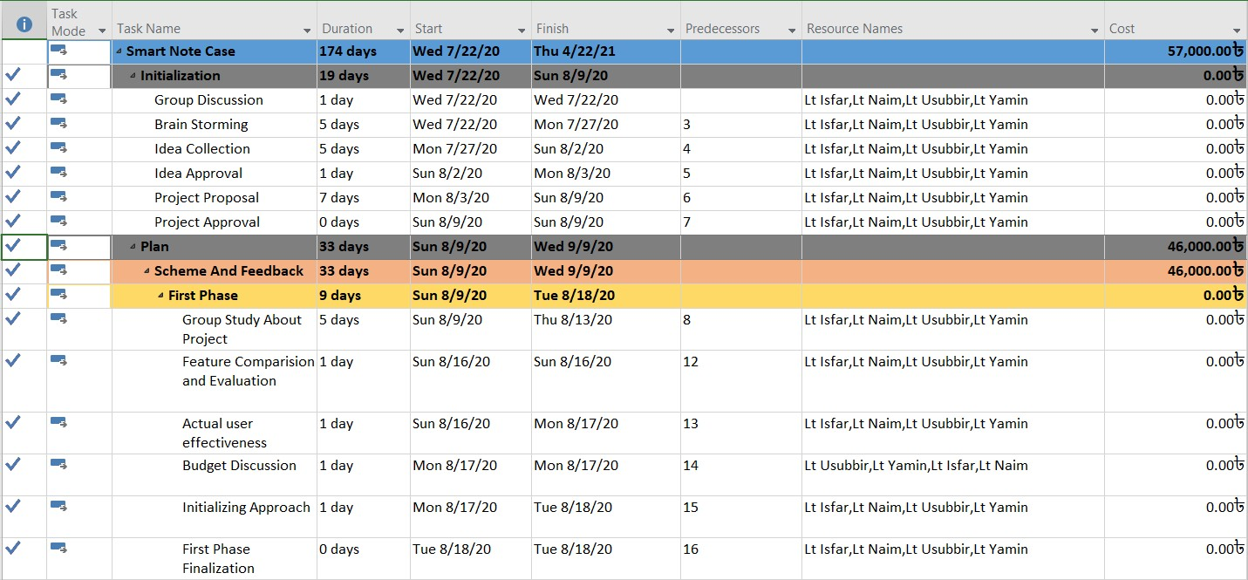
PROJECT SCHEDULING

Slide 12
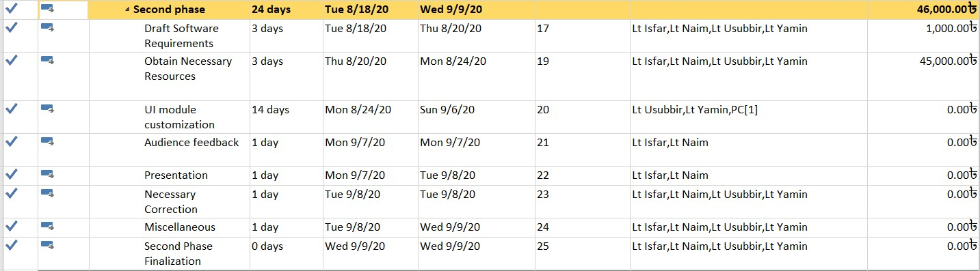
PROJECT SCHEDULING

Slide 13
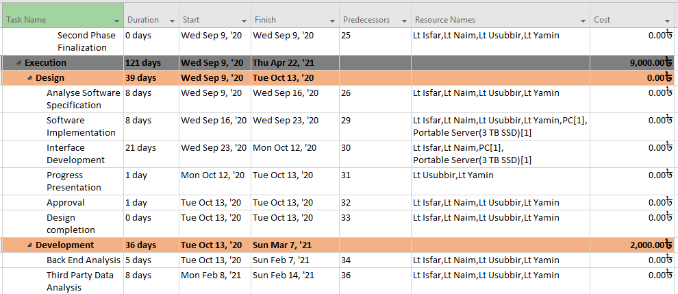
PROJECT SCHEDULING

Slide 14
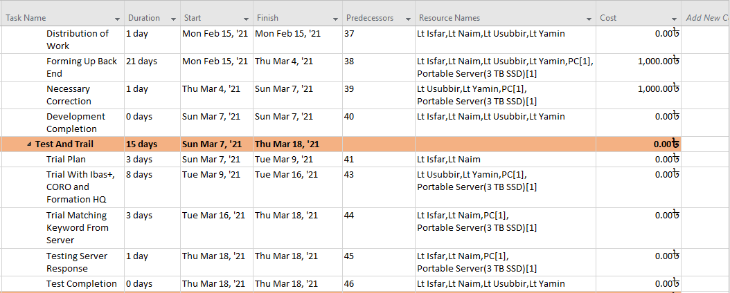
PROJECT SCHEDULING

Slide 15
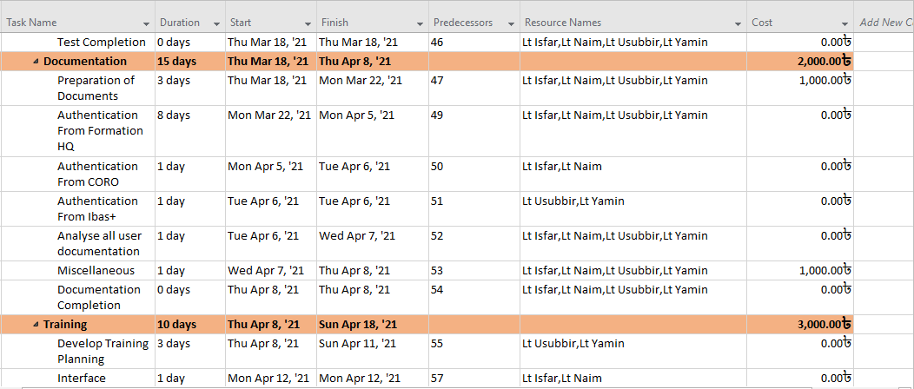
PROJECT SCHEDULING

Slide 16
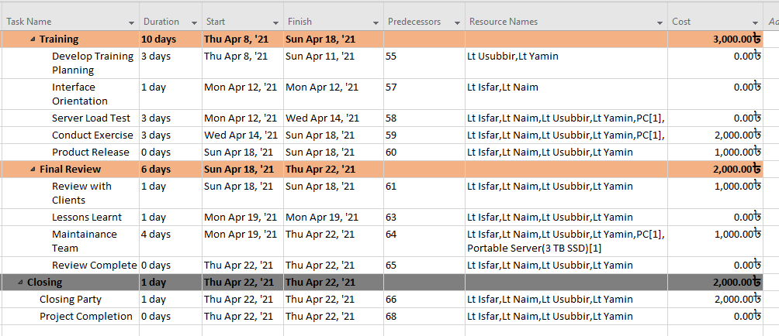
PROJECT SCHEDULING

Slide 17
PROJECT SCHEDULING

Slide 18
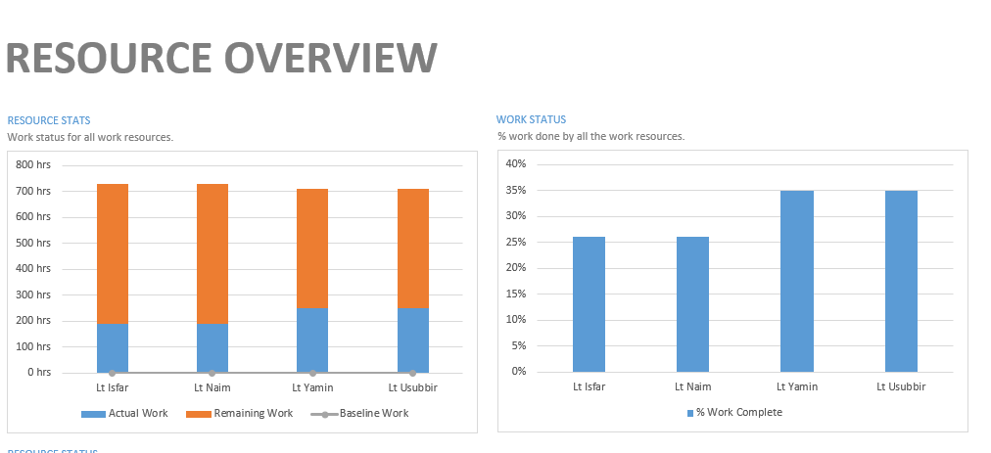
PROJECT SCHEDULING

Slide 19
USER REQUIREMENTS
To collect the user requirements, we had to interact with the MIST student officers of different
departments staying in Dhaka Mess. After interaction with the officers we have identified and
sorted their requirements. The interaction consisted of verbal interviews with question answer
sessions and conducting of a mini-survey. Then we have consulted with our team members for
identifying the problems and changed the requirements as per the survey and interview
conducted.

Slide 20
USER REQUIREMENTS
Convenient interface.
[Source: Interview of Lt Shabir, EECE Dept, MIST]
A copy of the documents preserved and accessible in mobile storage.
[Source: Feedback of Mini Survey at Dhaka Mess, Dhaka]
Better security and good protection.
[Source: Interview of Lt Labid, ME Dept]
Documents copied by scanning.
[Source: Feedback of Mini-survey at Dhaka mess, Dhaka]

Slide 21
USER REQUIREMENTS
Pay Slip acquired automatically.
[Source: Interview of Lt Shabir, EECE Dept]
Accessible from various platforms.
[Source: Interview of Lt Araf, EECE Dept]
Provide the up-to-date service.
[Source: Feedback of Mini-survey at Dhaka mess, Dhaka]
Notification alert system so that the users don’t miss anything.
[Source: Feedback of Mini-survey at Dhaka mess, Dhaka]

Slide 22
SYSTEM REQUIREMENTS SPECIFICATION
System should have a very clear and concise interface to avoid ambiguity.
System should be able to record of IPFT, RET, CORO Records of the particular officer inside the database.
System should be properly secured by two factor authentication. System interface should be accessible to only the authorized users.
System should be able to upload personal documents manually using users camera and other scanning applications.
Email Authentication for Pay slip Acquirement.
Smart ID card recognition using QR code.
Developer team will update and make necessary corrections for fortnightly.
After every six months notification will be send to users whose IPFT record is missing in our Database.

Slide 23
SYSTEM ACHITECTURE
A system architecture is the conceptual model that defines the
structure, behavior, and more views of a system. An architecture
description is a formal description and representation of a system,
organized in a way that supports reasoning about the structures and
behaviors of the system.

Slide 24
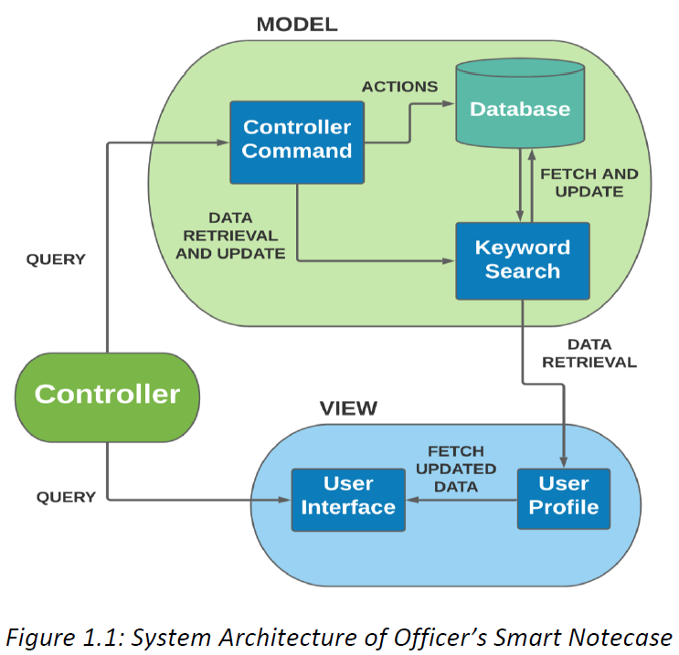
SYSTEM ACHITECTURE

Slide 25
SYSTEM ACHITECTURE
Model It is known as the lowest level which means it is responsible for maintaining data. Handle data logically so it basically deals with data. The model is actually connected to the database so anything you do with data. Adding or retrieving data is done in the model component. It responds to the controller requests because the controller never talks to the database by itself. The model talks to the database back and forth and then it
gives the needed data to the controller. Note: the model never communicated with the view directly.
View Data representation is done by the view component. It actually generates UI or user interface for the user. So at web applications when you think of the view component just think the Html/CSS part. Views are created by the data which is collected by the model component but these
data aren’t taken directly but through the controller, so the view only speaks to the controller.
Controller It’s known as the main man because the controller is the component that enables the interconnection between the views and the
model so it acts as an intermediary. The controller doesn’t have to worry about handling data logic, it just tells the model what to do. After
receiving data from the model it processes it and then it takes all that information it sends it to the view and explains how to represent to the user. Note: Views and models cannot talk directly.

Slide 26
CONTEXT
DIAGRAM
A system context diagram represents all the components
that may interact with the system, hence displays the entire
software system as a unit.
SYSTEM
MODEL
USE CASE
DIAGRAM
A use case diagram at its simplest is a representation of a
user’s interaction with the system that shows the relationship
between the user and the different use cases in which the
user is involved.
ACTIVITY
DIAGRAM
Activity diagram is basically a flowchart to represent the flow from
one activity to another activity. The activity can be described as an
operation of the system. The control flow is drawn from one operation
to another.
SEQUENCE
DIAGRAM
A sequence diagram shows object interactions arranged in time sequence.
It depicts the objects involved in the scenario and the sequence of
messages exchanged between the objects needed to carry out the
functionality of the scenario.

Slide 27
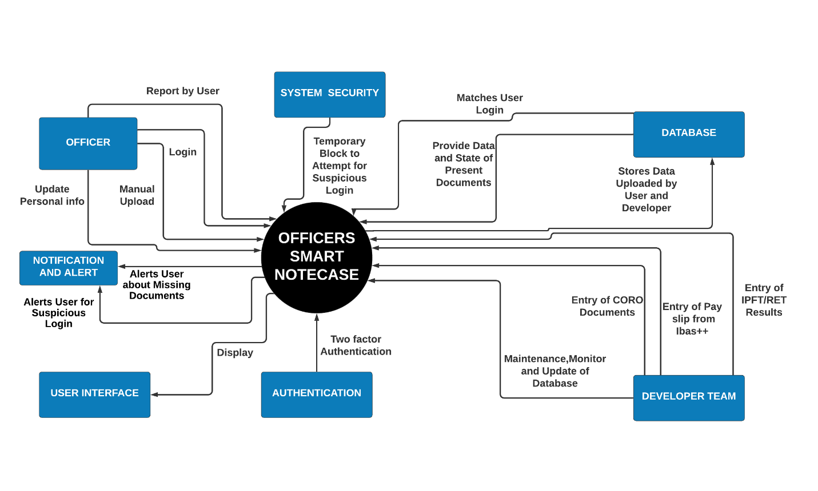
CONTEXT
DIAGRAM

Slide 28
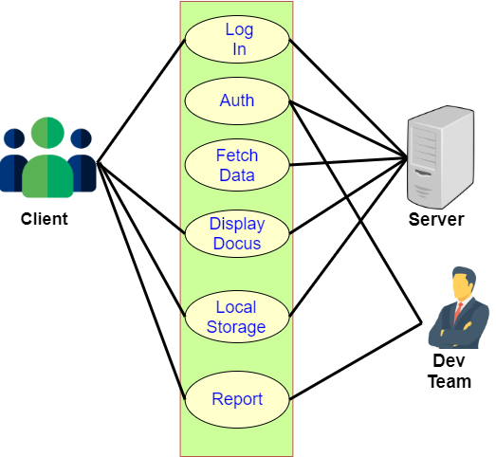
USE CASE
DIAGRAM
Figure 1.7: Use Case Diagram for Output System

Slide 29
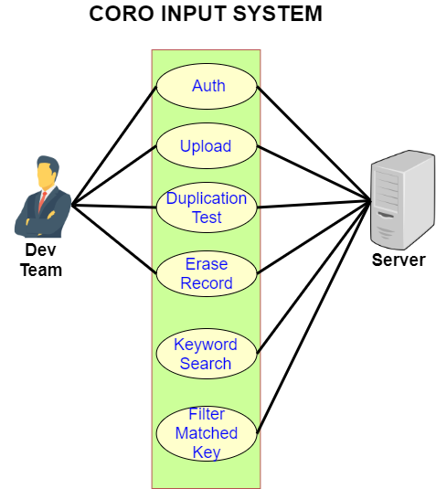
USE CASE
DIAGRAM
Figure 1.7: Use Case Diagram for CORO Input System

Slide 30
Authorization, Notification & Modification System
Actors | Authorized Clients Developer Team Server
Data | Login authority information Client personal data Report in specific times
Stimulus | Client himself In some cases, Developer Team
Response | Block Unauthorized Access After 5 wrong attempts Notification Alert
Work Flow | Developer Team System login Data Input System modification in regular interval Monitoring user data System debugging Client User login View personal documents Entry of new documents Notification alert Report
Comments | It is a database, which holds the information and documents of the clients. The clients can easily access documents and any kind of updates can be made as per the requirement.
USE CASE
DIAGRAM

Slide 31
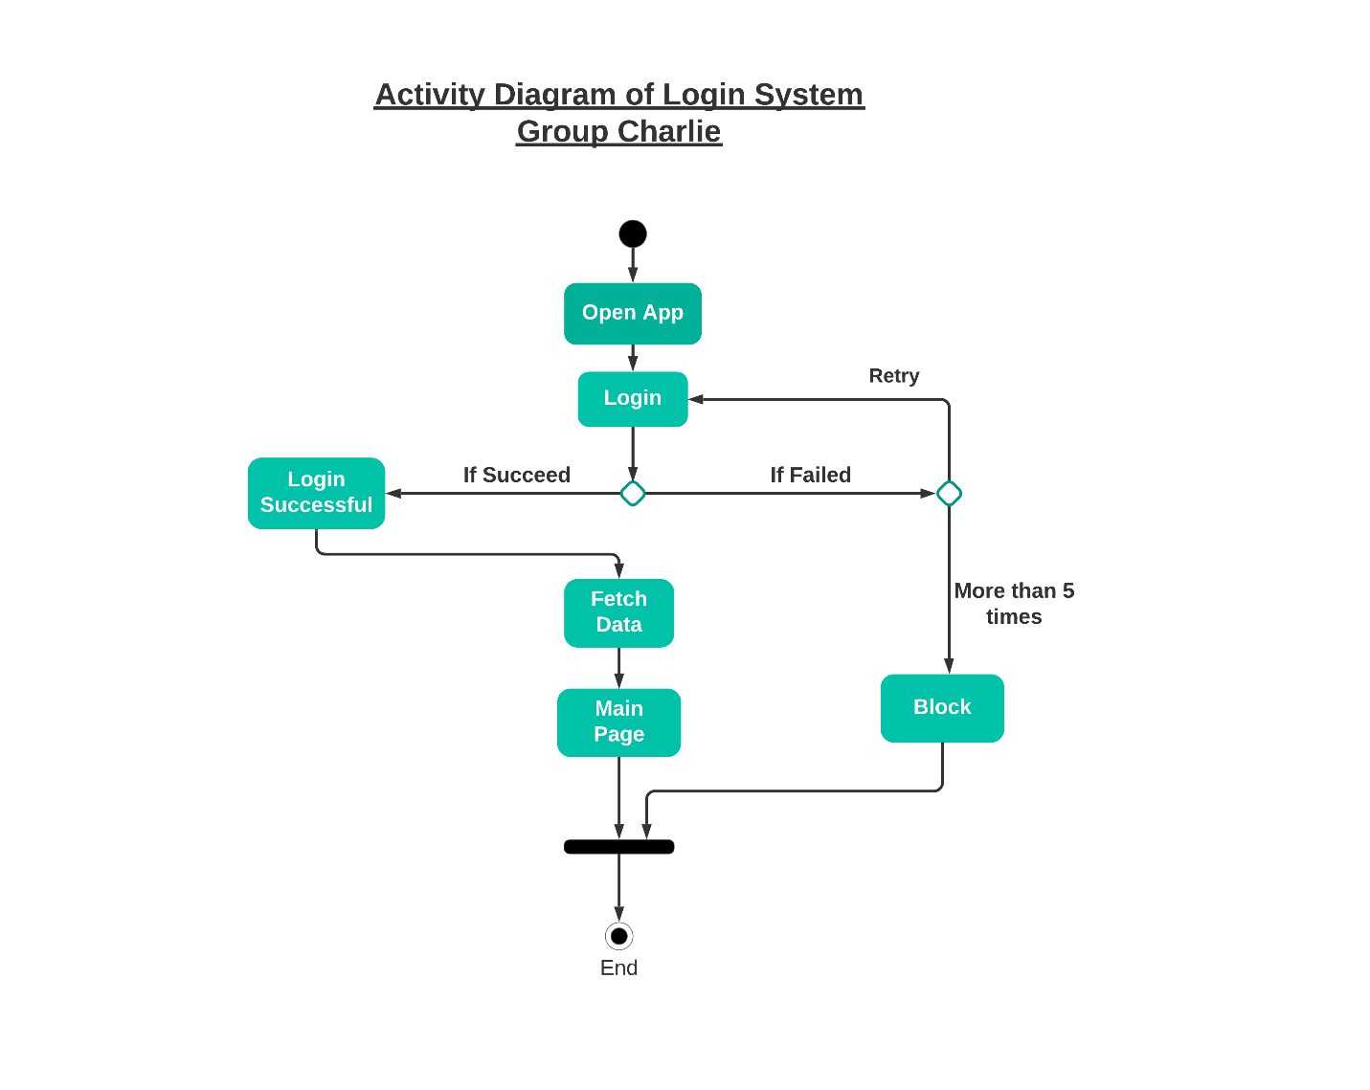
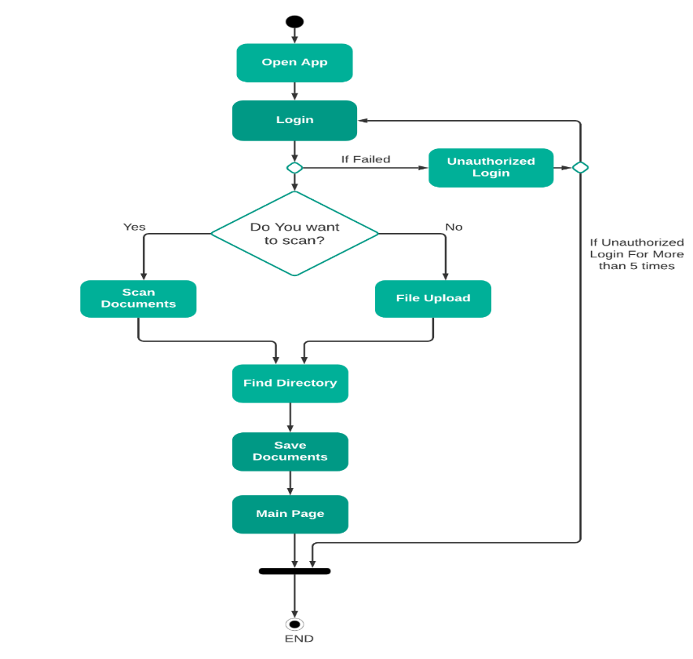
ACTIVITY DIAGRAM
Figure : Activity diagram of User Login System
Figure 1.6: Activity Diagram of Document Upload System

Slide 32
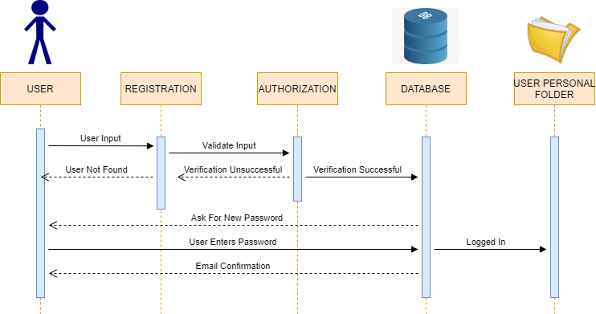
SEQUENCE DIAGRAM
Figure 1.7: Sequence Diagram For User Registration

Slide 33
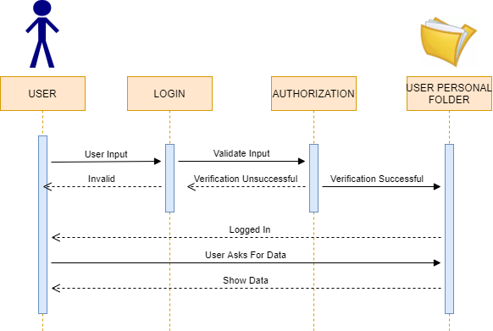
SEQUENCE DIAGRAM
Figure 1.8: Sequence Diagram for Document Extraction by User

Slide 34
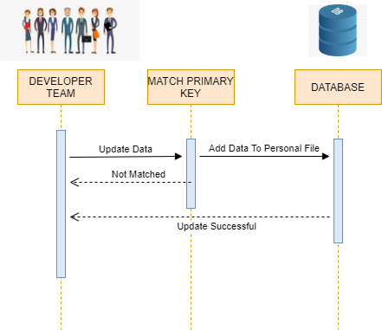
SEQUENCE DIAGRAM
Figure 1.9: Sequence Diagram for Data Upload by Developer Team

Slide 35


USER-INTERFACE
DIAGRAM

Slide 36
UI DESIGN

Slide 37
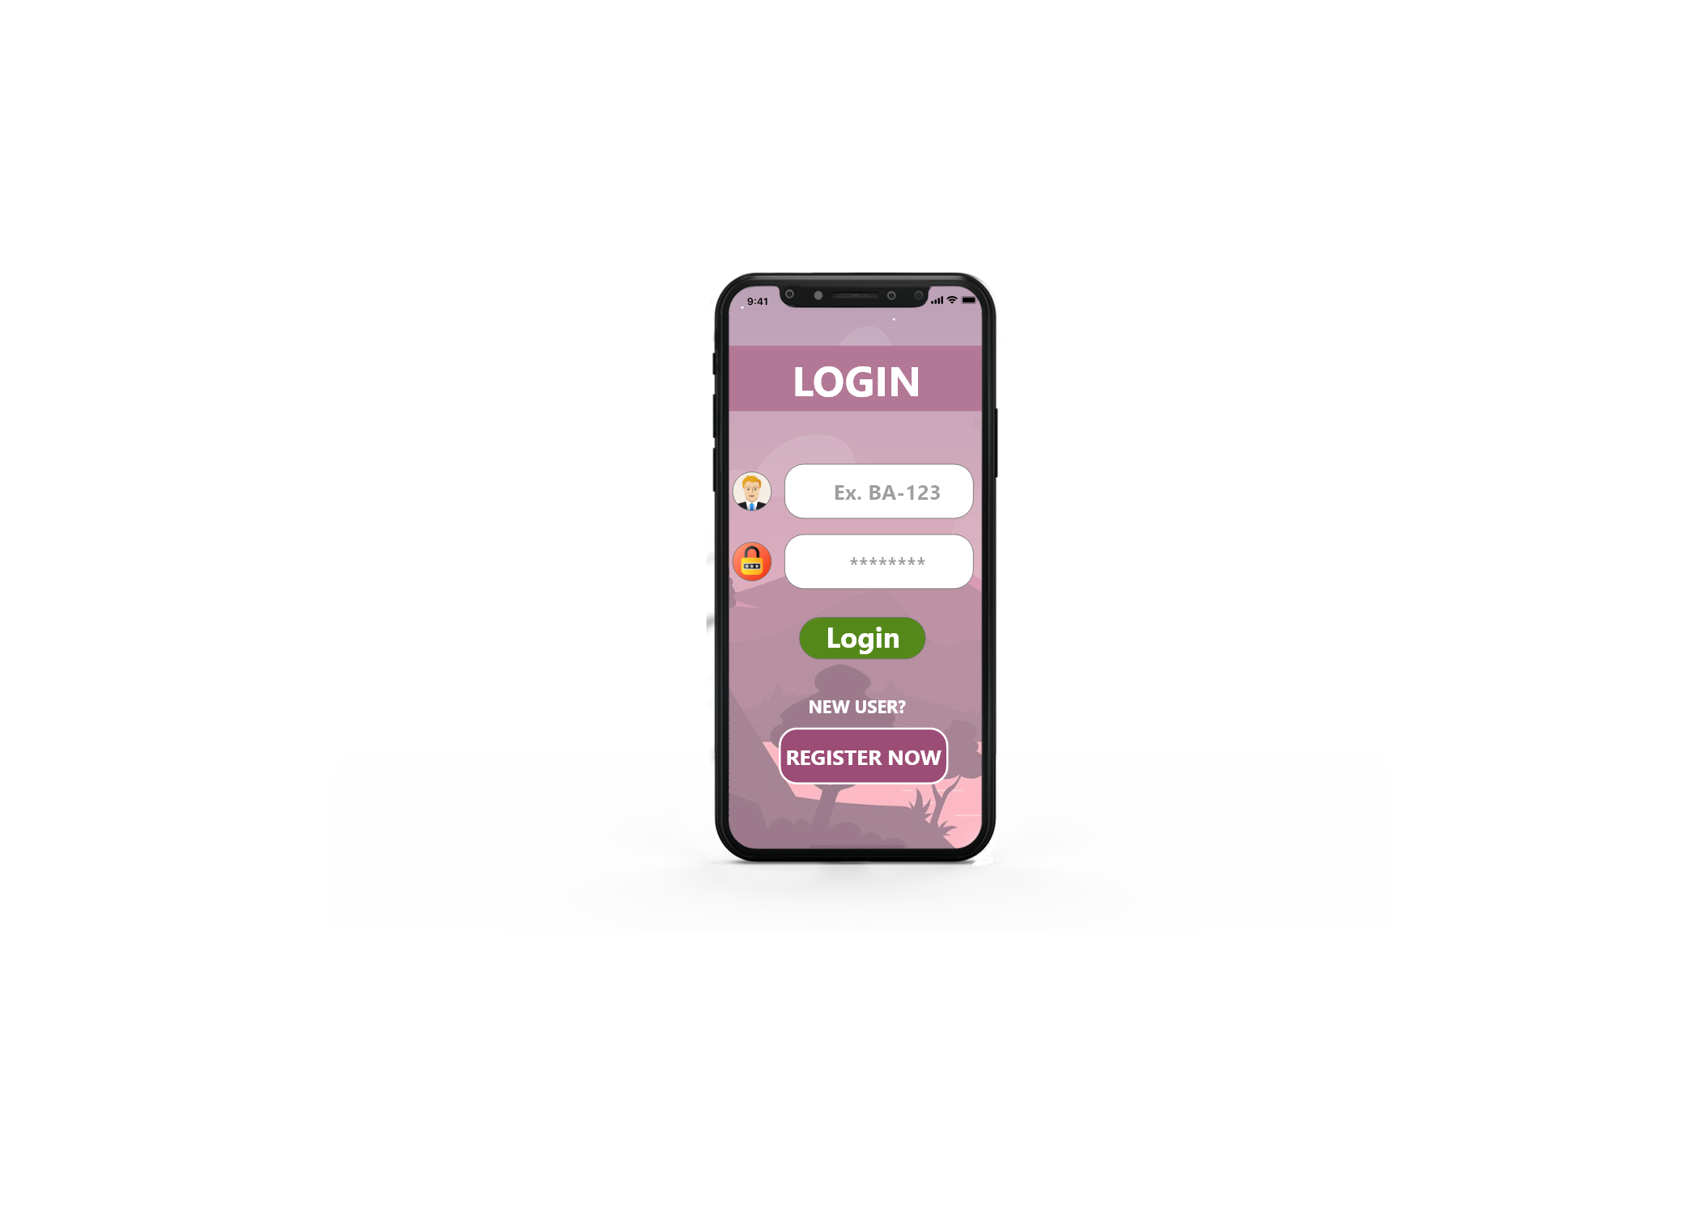
UI DESIGN

Slide 38
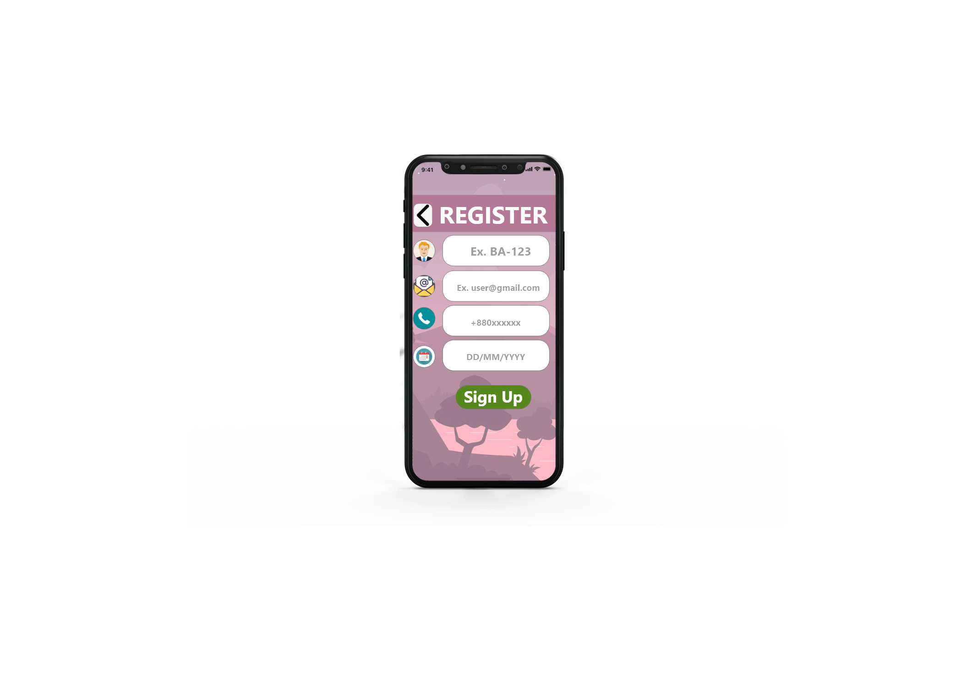
UI DESIGN

Slide 39
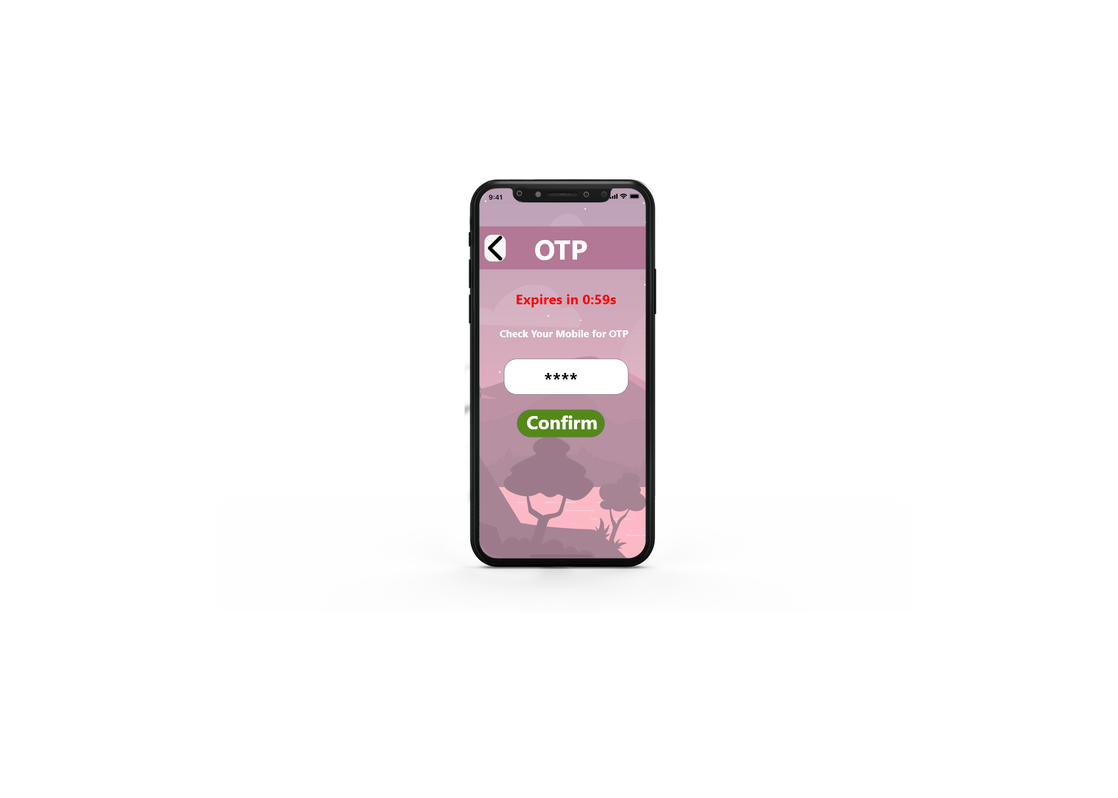
UI DESIGN

Slide 40
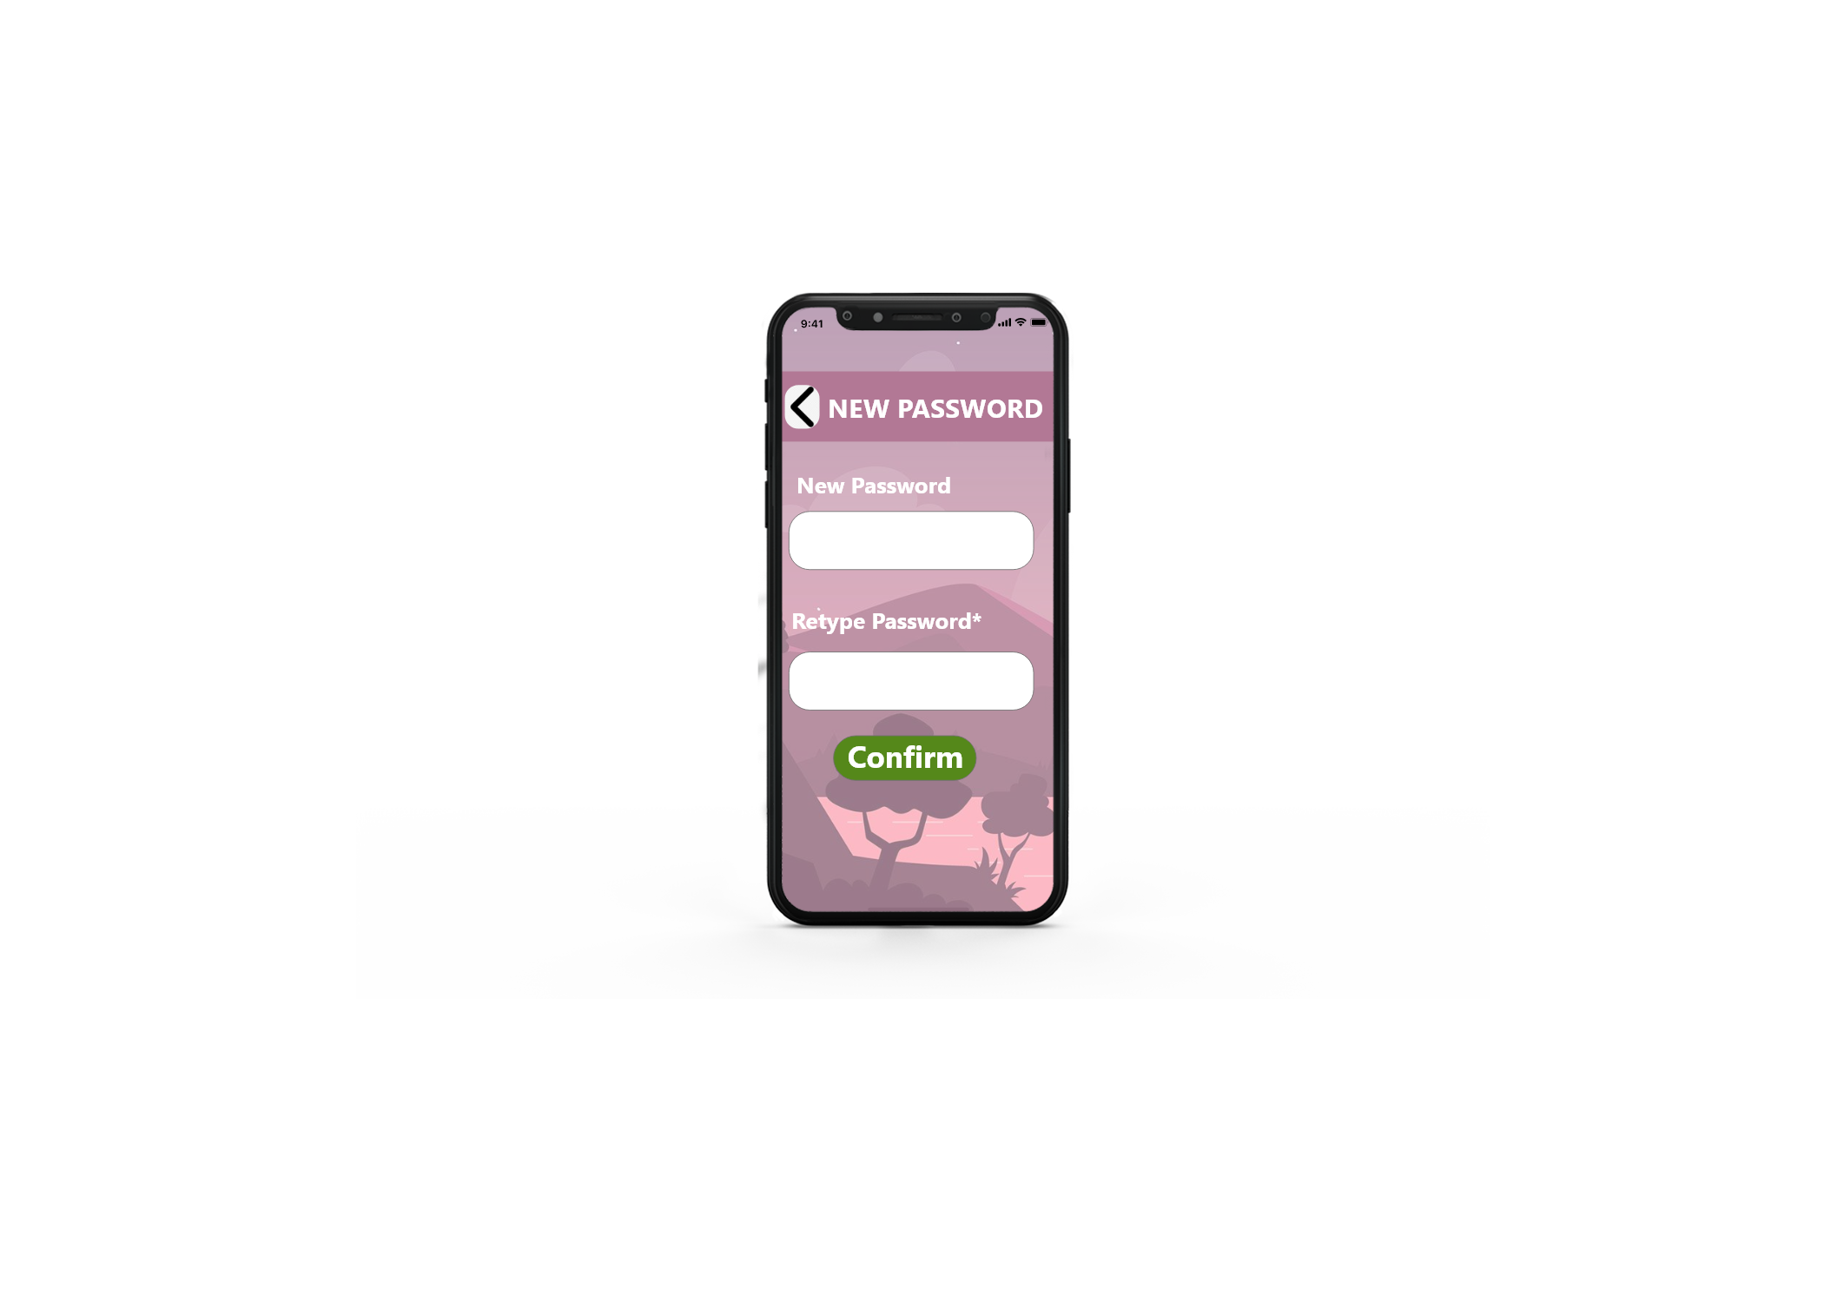
UI DESIGN

Slide 41
UI DESIGN

Slide 42
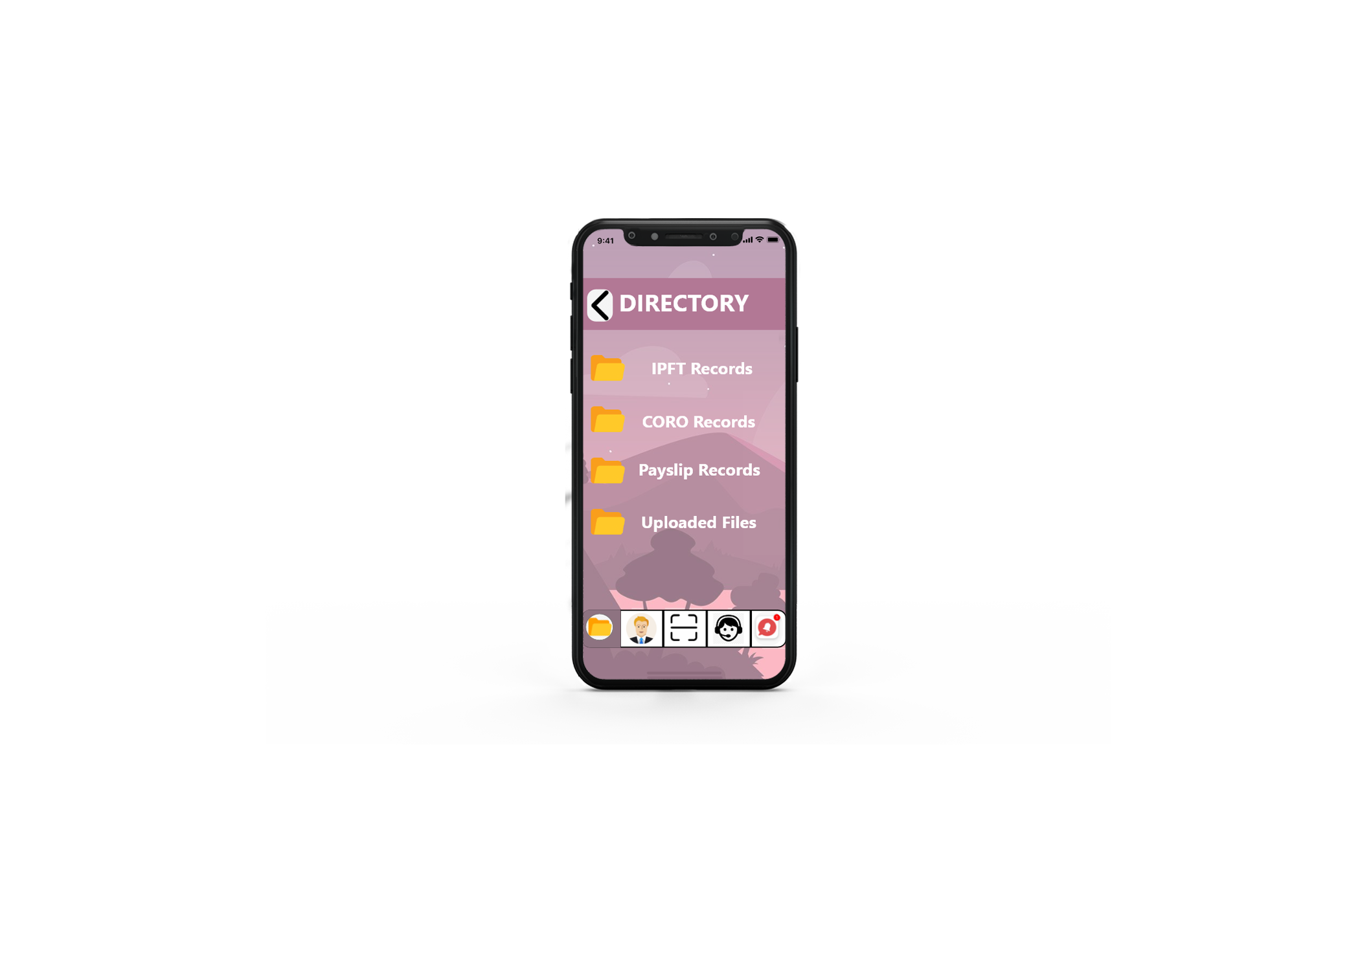
UI DESIGN

Slide 43
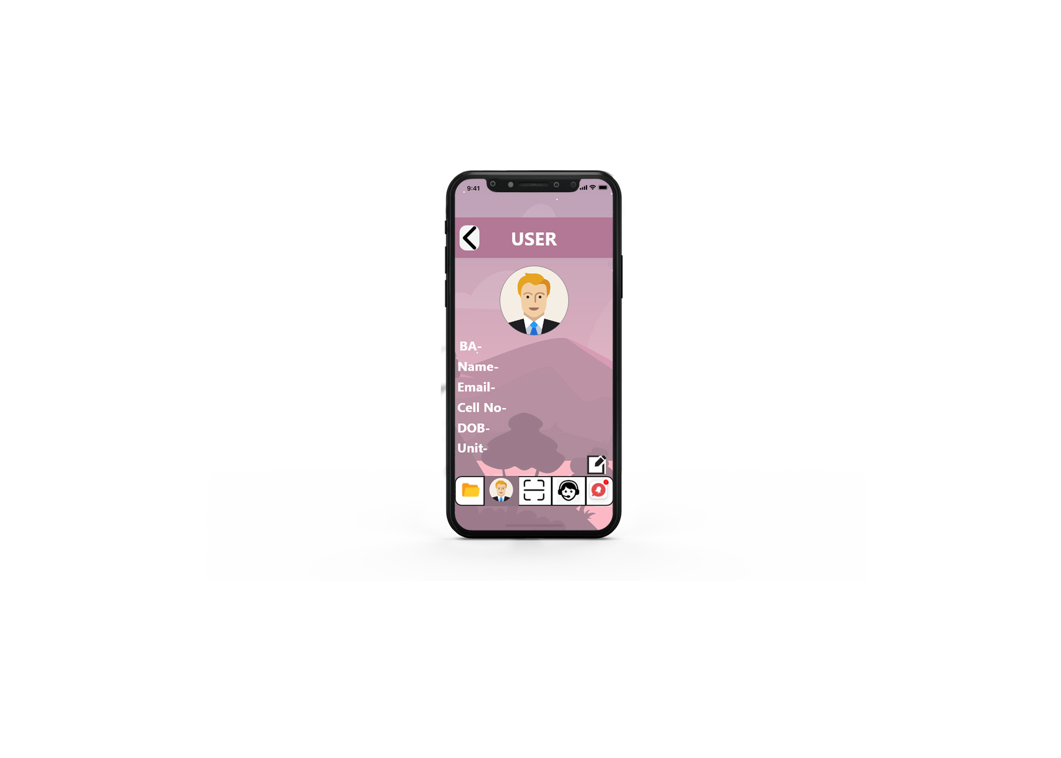
UI DESIGN

Slide 44
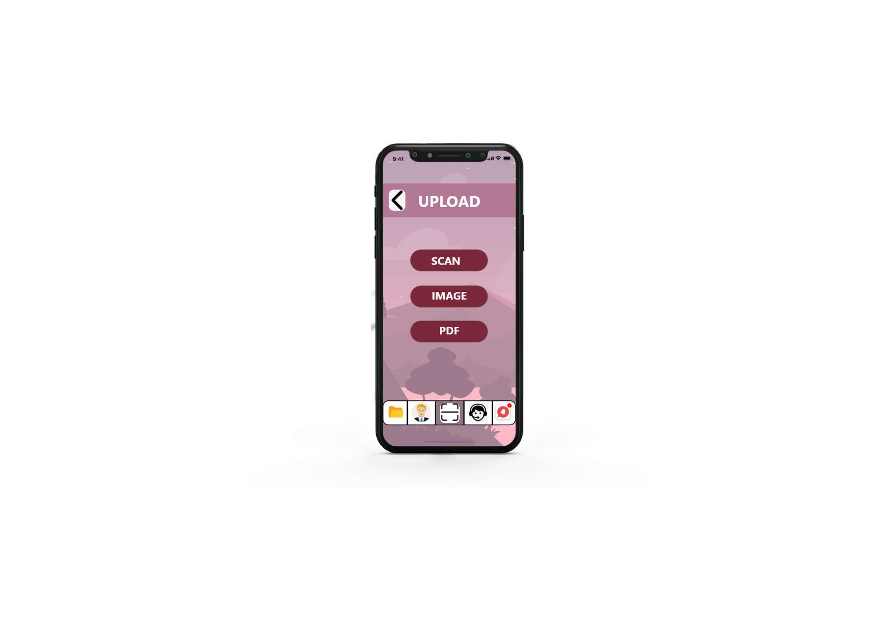
UI DESIGN

Slide 45
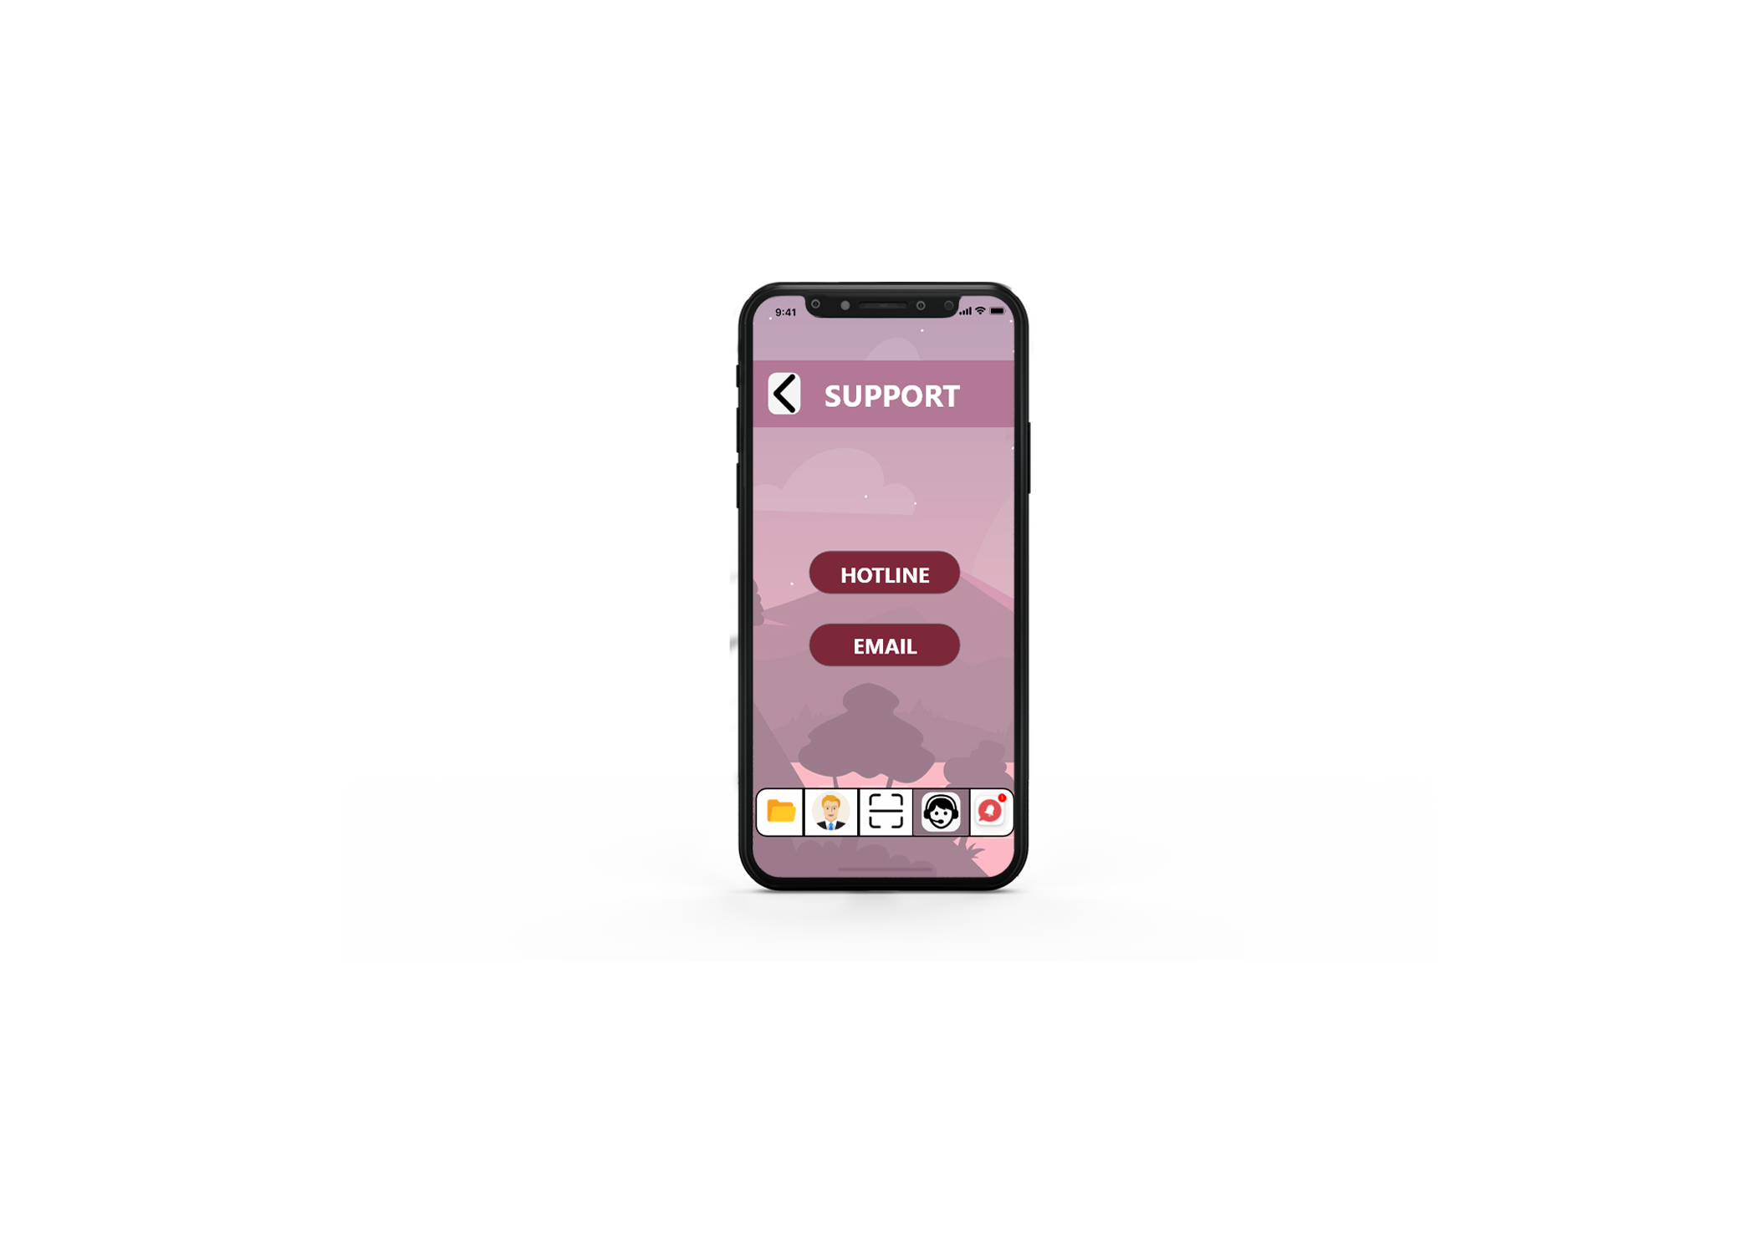
UI DESIGN

Slide 46
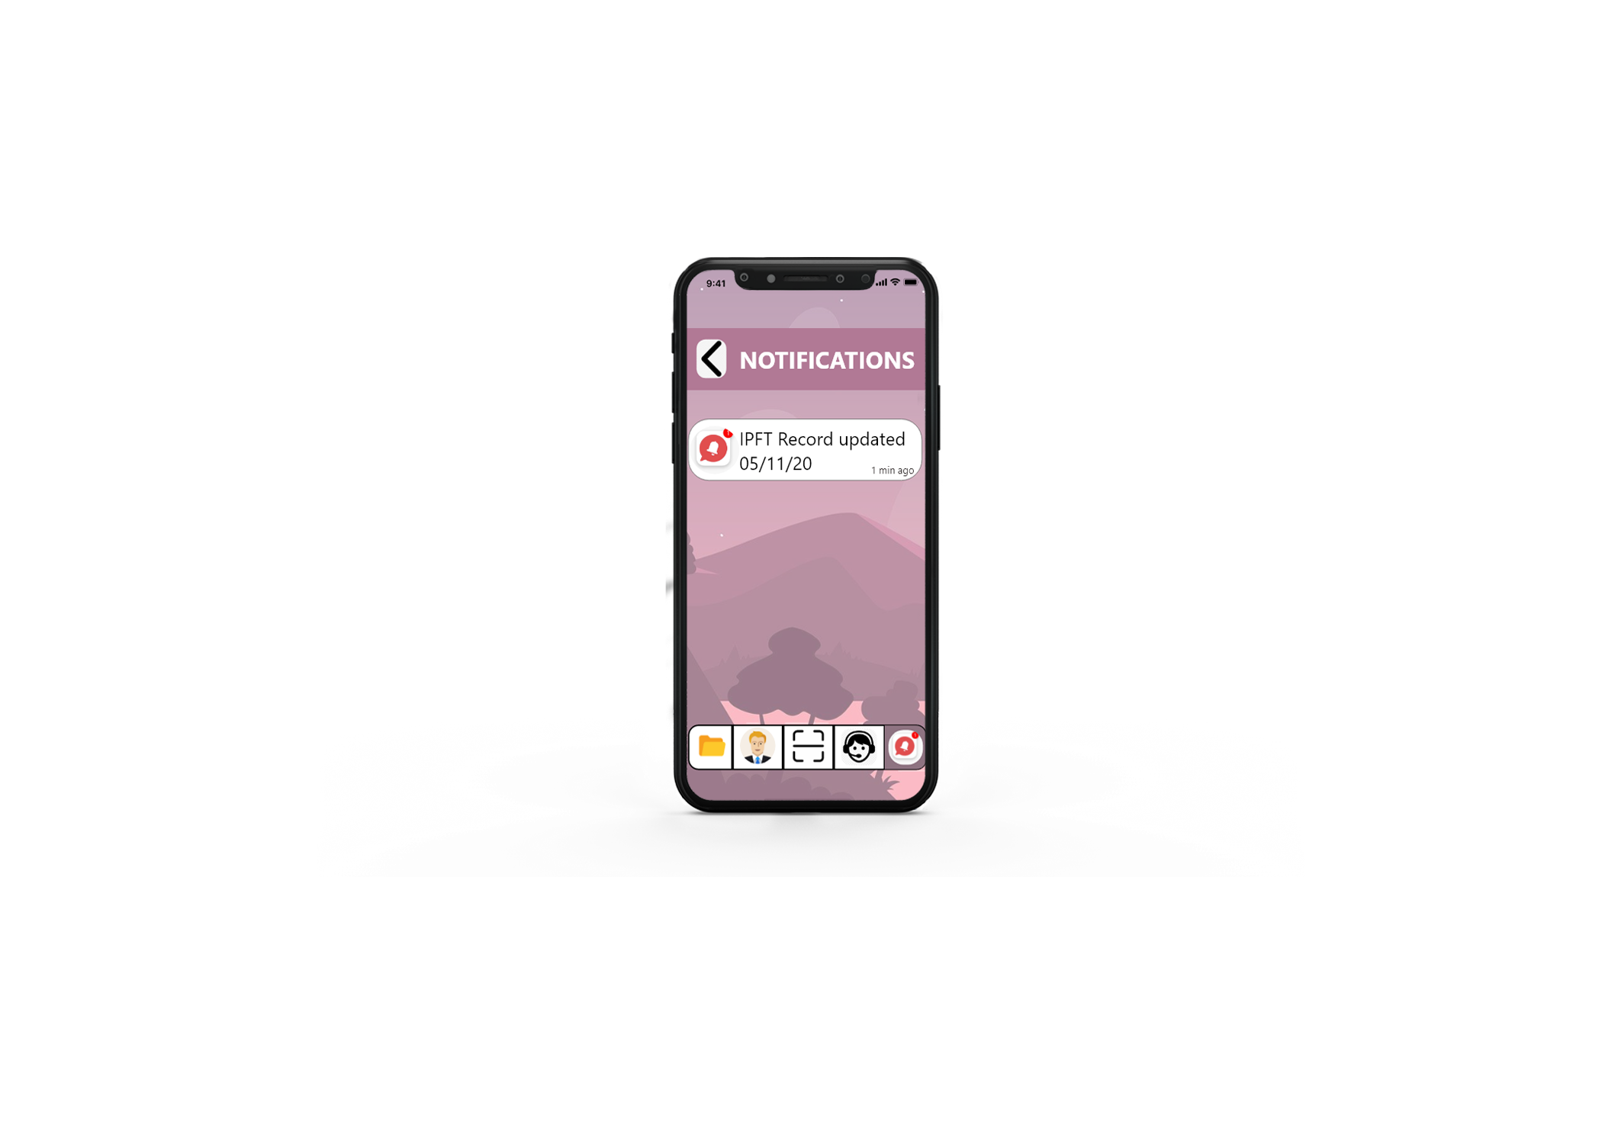
UI DESIGN

Slide 47
ANY QUERY ??

Slide 48
Thank you

